Slide 1
AI-Powered Legal Document Intelligence Assistant
Multi-Model NLP System for Summarization, QA, RAG, and Risk Analysis
Team members:
Pavan Kusampudi – 700762366
Ajith Bonda - 700766394
Subha Sri Lakshmi Achyutha - 700766668
Tejaswini Kolluru - 700773943

Slide 2
ABSTRACT
This project presents a full-stack NLP system designed to analyze, summarize, and interpret complex legal documents using advanced transformer-based architectures. The system integrates multiple functionalities:
Fine-tuned T5 and BART summarizers
Entity extraction
Extractive and generative question answering
Retrieval-Augmented Generation (RAG)
Risk-level classification of legal clauses
Conversational AI capabilities
This platform is built using FastAPI (backend), React (frontend), Groq LLMs (generative QA), and custom-trained transformer models. Experiments on the BillSum dataset demonstrate significant improvements in legal summarization quality and QA accuracy. This project introduces a unique clause-level risk classifier that aids legal compliance and decision-making.

Slide 3
INTRODUCTION
Legal documents such as government bills, regulations, and policy documents are typically long, dense, and difficult to interpret.
They contain embedded definitions, cross-references, exceptions, and legal obligations spread across multiple sections.
Understanding such documents requires substantial time and domain expertise.
This project applies modern NLP techniques to bridge this gap by building a user-friendly, intelligent system that converts complex legal language into understandable insights.
The system combines transformer models, LLM reasoning, and retrieval mechanisms to support summarization, question answering, and risk interpretation.

Slide 4
MOTIVATION
Manual reading and comprehension of legal documents is slow, tedious, and error-prone.
Traditional NLP approaches (rule-based summaries, keyword extraction) fail to capture deeper meaning because:
They cannot process long contexts
They miss semantic and syntactic dependencies
They cannot reason about legal implications
They fail to generalize across legal structures
They lack conversational understanding
With the rise of transformer models and retrieval-driven LLM reasoning, there is an opportunity to automate legal document understanding.
Our motivation is to build an AI assistant that equips users, analysts, and students with fast, accurate, and interactive legal insights.

Slide 5
PROPOSED SYSTEM OVERVIEW
We propose an advanced, multi-component Legal Document Intelligence Assistant that performs:
Document Summarization using fine-tuned T5 and BART
Named Entity Recognition for legal entities
Extractive QA for span-based answers
Generative QA using Groq Llama-3
RAG (Retrieval-Augmented Generation) for grounding answers
Clause-Level Risk Classification (High/Medium/Low)
Conversational AI with memory retention
Full-Stack Web Application (React + FastAPI)

Slide 6
SYSTEM ARCHITECTURE
Frontend (React):
The frontend provides a clean interface for interacting with legal text.
It includes dedicated tabs for summarization, NER, QA, RAG, chat assistant, and risk analysis.
Users can upload PDFs, paste text, choose between T5, BART, or Groq models, and view outputs in real-time.
Backend (FastAPI):
Our backend is built with FastAPI and exposes modular endpoints for each NLP function.
Each API is optimized for low-latency responses and supports both local models and Groq-based inference.
The backend also manages session-based conversational memory and vector retrieval.
Models:
We incorporate multiple transformer models, including fine-tuned T5 and BART for summarization, a Roberta model for extractive QA, Groq Llama-3 for advanced generative reasoning, and BART-MNLI, Zero shot classification for legal risk classification.
The system also uses sentence embeddings for RAG workflows.

Slide 7
DATASET & PREPROCESSING
HuggingFace Dataset: https://huggingface.co/datasets/FiscalNote/billsum
We used the huggingFace BillSum dataset, a large legal dataset created from U.S. Congressional Bills and California State legislative documents.
It contains detailed legal text along with high-quality, human-written summaries, making it ideal for training summarization models.
Scale:
The dataset contains 50,000+ sentences, ensuring that our models learn from a wide variety of legal tones, structures, obligations, and definitions.
Preprocessing Steps:
We cleaned the raw documents by removing headers, footers, metadata, and procedural boilerplate sections.
We normalized text spacing, fixed sentence boundaries, merged multiline clauses, and prepared consistent training examples.
Documents were chunked into manageable token lengths (512–1024 tokens) to suit transformer models.

Slide 8
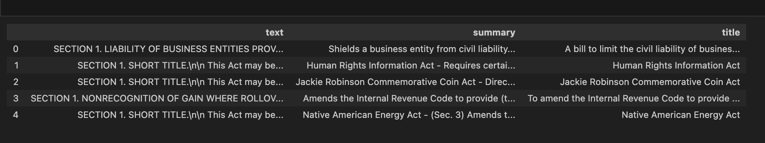
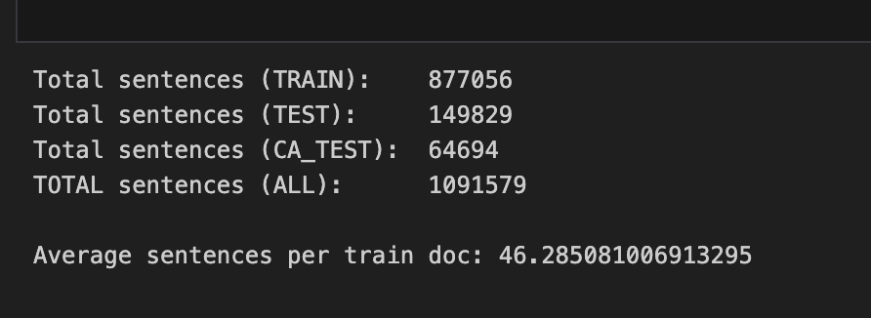

Sample Data

Slide 9
SUMMARIZATION MODELS
T5-Billsum:
We fine-tuned T5 on the BillSum dataset to generate concise and accurate summaries.
T5 is efficient for short and medium-length summaries and performs well at capturing the essence of legal clauses.
BART-Billsum:
BART, also fine-tuned on BillSum, produces more fluent and human-like summaries.
It handles long, complex sentences better and preserves context more effectively.
Training Details:
Both models were trained on Google Colab A100 GPUs over multiple epochs using AdamW optimizer and learning rate scheduling.
We used ROUGE-1, ROUGE-2, and ROUGE-L metrics because these three metrics are the standard evaluation suite for summarization tasks. They capture unigram overlap (content), bigram overlap (fluency), and longest common subsequence (structural quality). This aligns with the BillSum benchmark and state-of-the-art summarization research.

Slide 10
NAMED ENTITY RECOGNITION (NER)
Functionality:
The NER module extracts important legal entities such as organizations, laws, government agencies, dates, places, and legal roles.
Importance:
Entity extraction helps users instantly identify key actors and components of a legal document.
For example, it highlights references like “Internal Revenue Code,” “Veterans’ Organizations,” or “State of California.”

Slide 11
QUESTION ANSWERING MODULE
Extractive QA:
Extractive QA is powered by a Roberta-based model that identifies exact answer spans within the text.
This method is ideal for fact-based or definition-based questions, such as “What is the definition of gross negligence?”
Generative QA (Groq Llama-3):
Generative QA uses Groq’s ultra-fast Llama-3 models to produce natural-language responses.
It is capable of reasoning over entire documents and answering broader questions that require interpretation.
Conversational QA:
We added a chat assistant that maintains conversation history, allowing the user to ask follow-up questions without repeating context which is similar to ChatGPT but specialized for legal text.

Slide 12
RAG PIPELINE
Chunking:
Documents are divided into sections or chunks so that each part can be embedded independently.
This allows the system to locate the most relevant text quickly.
Embedding & Storage:
We generate embeddings using MiniLM models and store them in an in-memory vector database.
This makes retrieval extremely fast.
Retrieval:
When a user asks a question, the system retrieves the top-k relevant chunks based on semantic similarity.
Generation:
These retrieved chunks are passed to Groq LLM, which produces accurate, context-grounded answers.

Slide 13
CLAUSE-LEVEL RISK CLASSIFICATION
Purpose:
This is a unique feature that identifies the legal implications of each clause in a document.
Classification Categories:
High Risk: Clauses mentioning liability, penalties, violations, or criminal misconduct.
Medium Risk: Compliance rules, procedural obligations, or conditions.
Low Risk: General definitions, statements of purpose, context, or non-critical content.
Method:
We use BART-large MNLI in a zero-shot setup to determine risk levels. Sections are split and analyzed independently, then displayed with color-coded badges

Slide 14
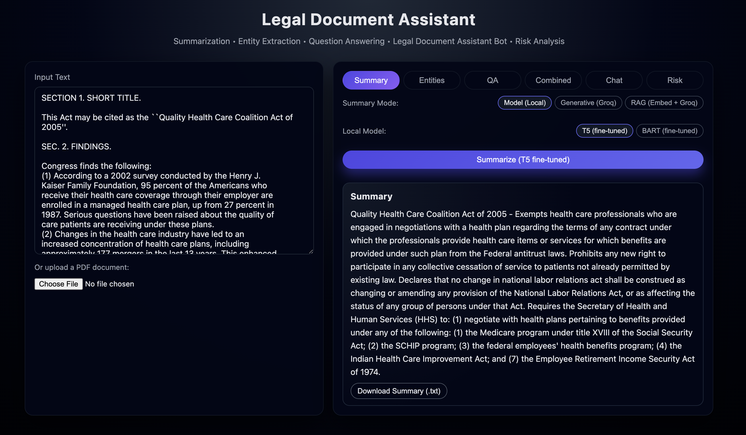
DEMO OUTPUTS

Slide 15
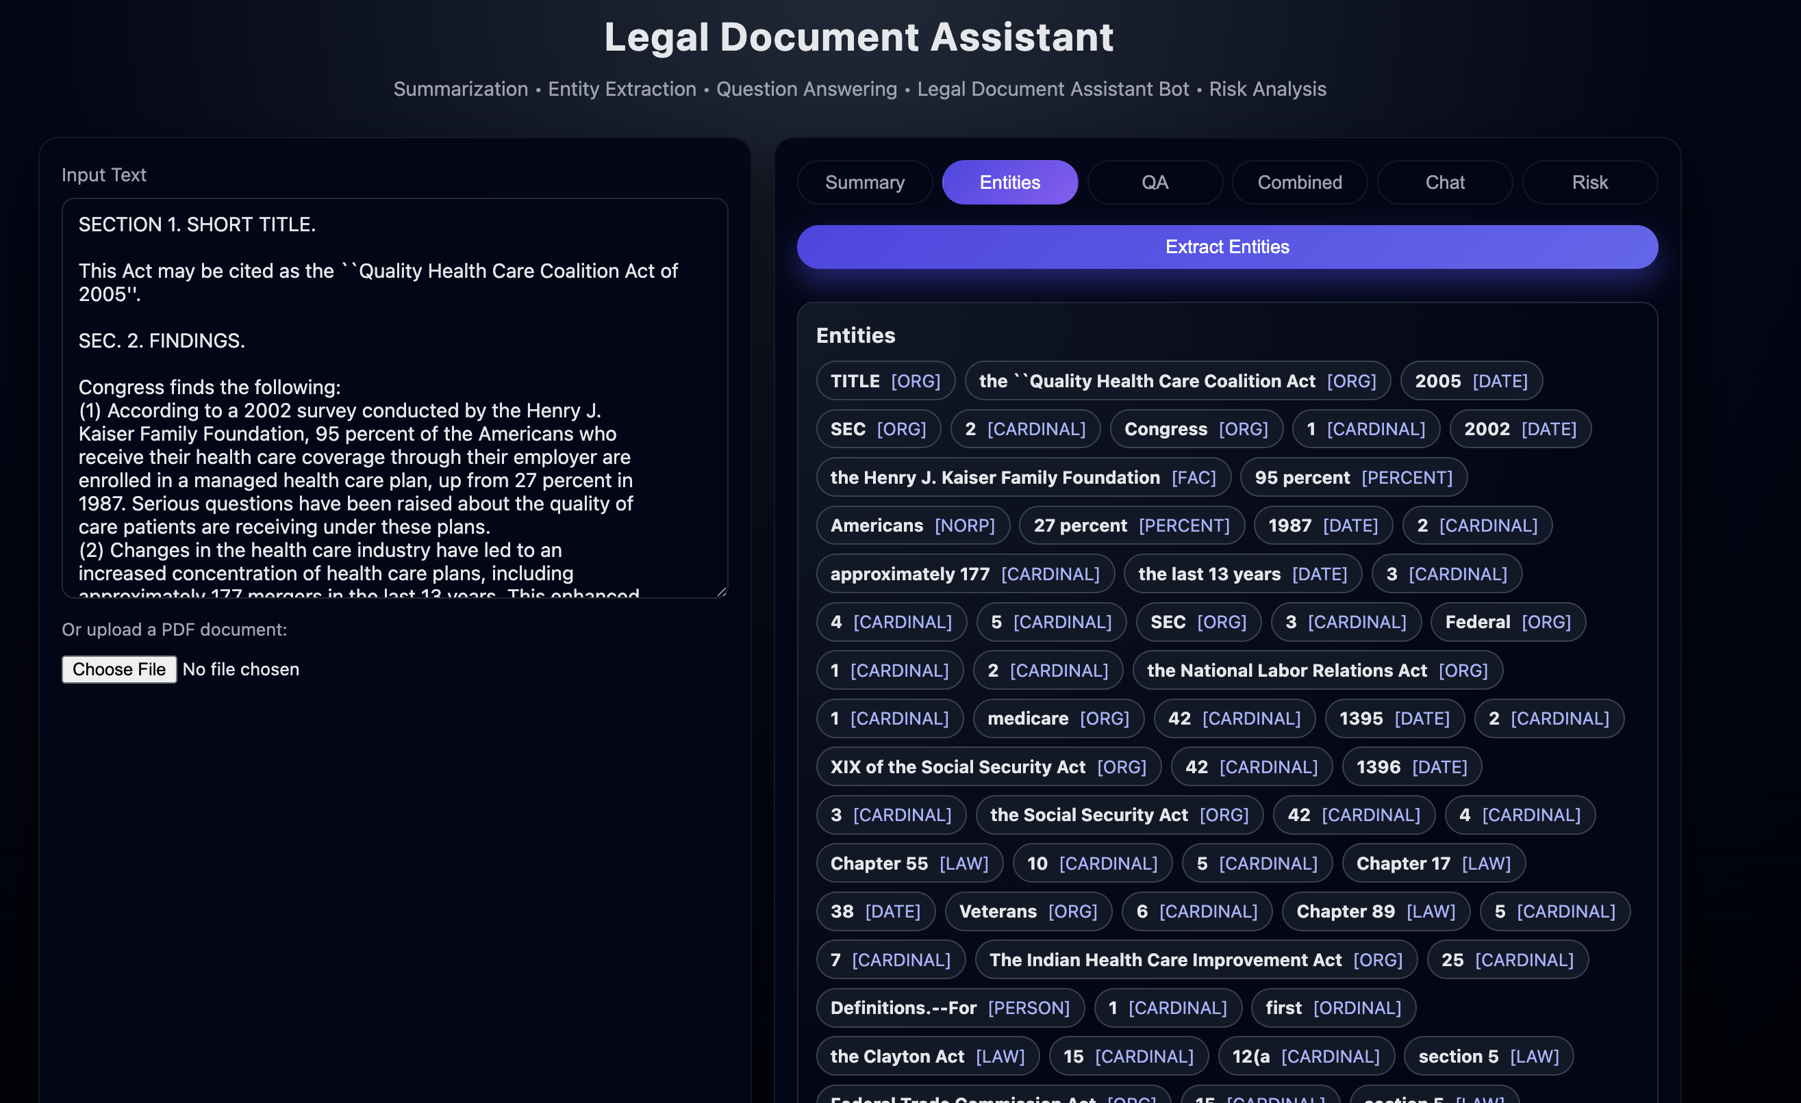
DEMO OUTPUTS

Slide 16
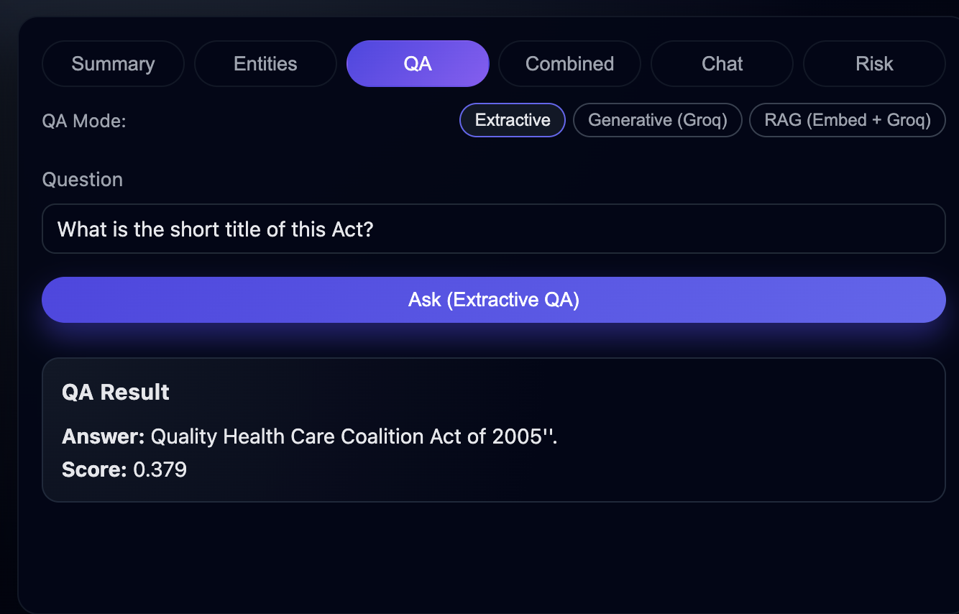
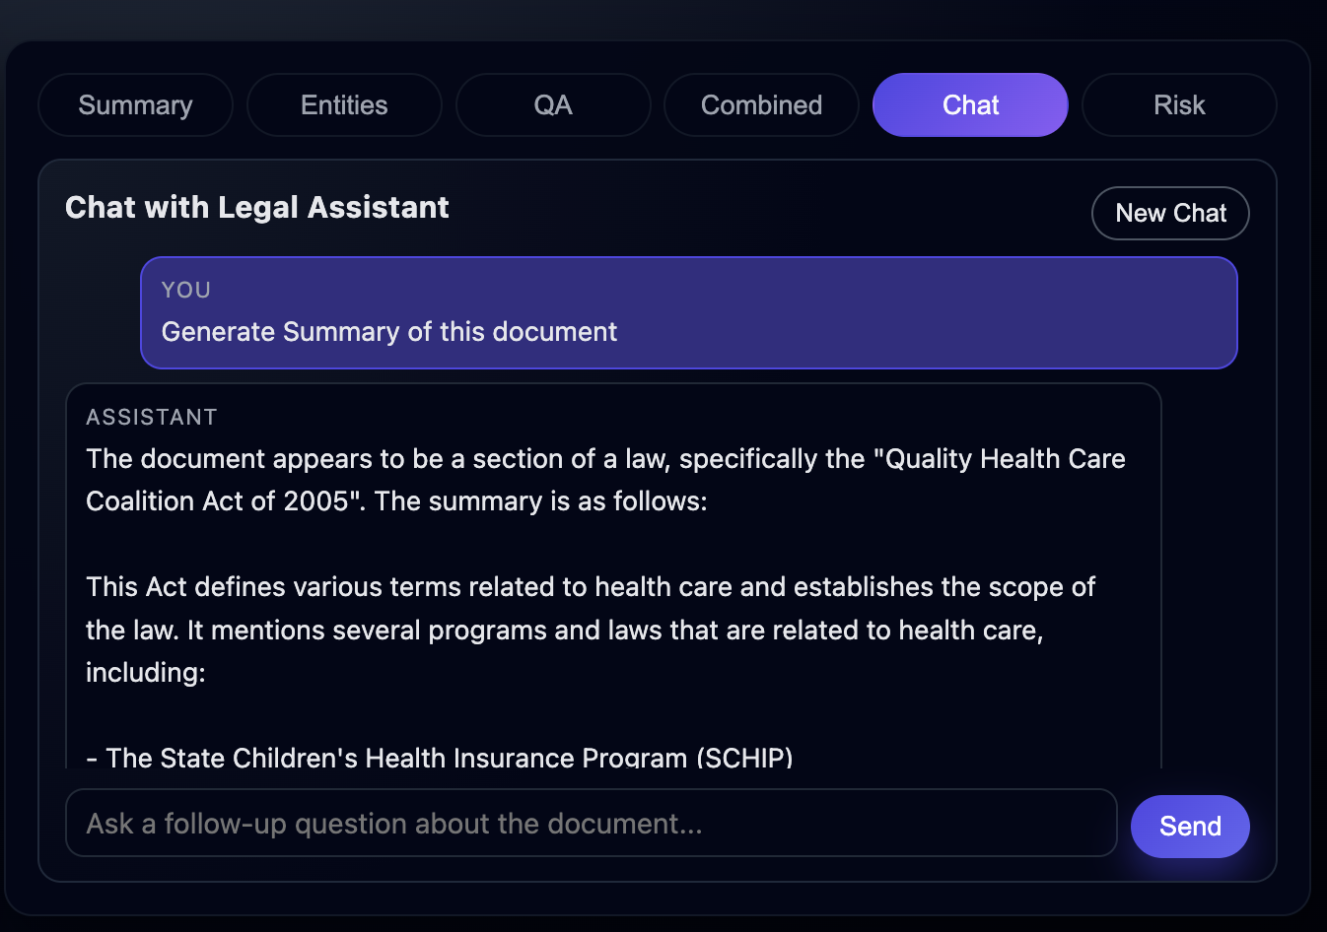
DEMO OUTPUTS

Slide 17
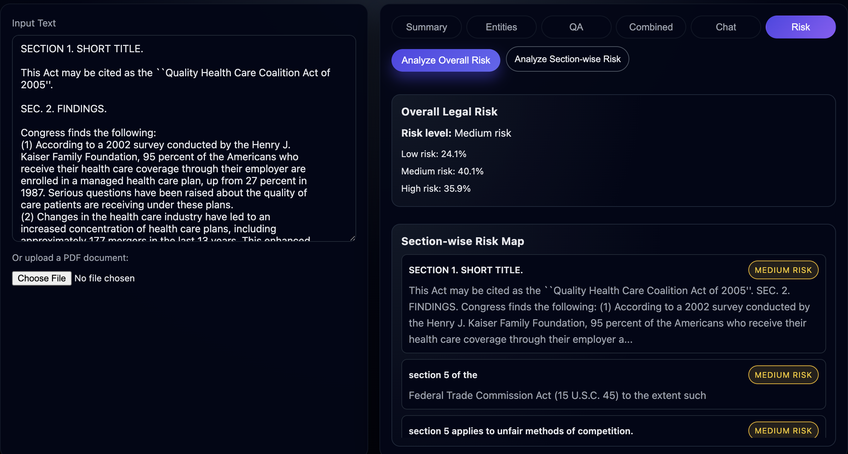
DEMO OUTPUTS

Slide 18
EXPERIMENTAL RESULTS
Summarization Evaluation:
T5 excels at producing short summaries, while BART generates more readable narrative summaries. Both outperform baseline models after fine-tuning.
QA Evaluation:
RAG-based QA achieved the highest factual accuracy, especially for complex legal questions. Extractive QA works best for definition-type questions.
Risk Classification:
The classifier correctly identifies risky legal clauses and provides consistent risk-level distinctions in test cases.

Slide 19
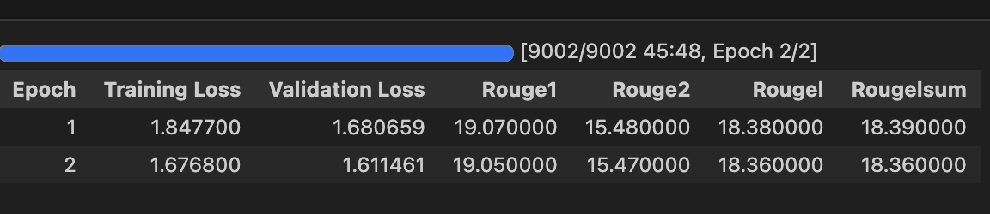
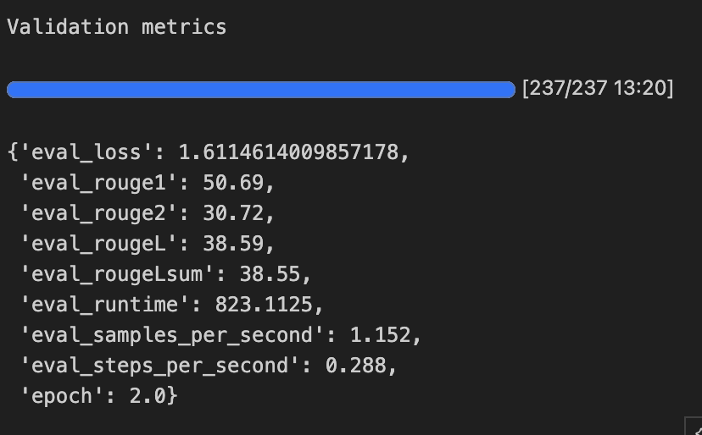
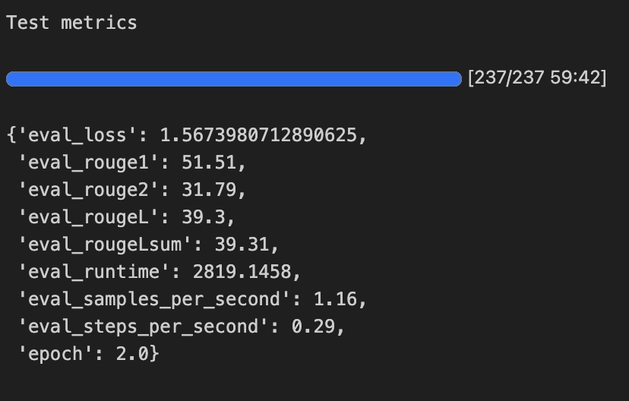
T5 Model Results

Slide 20
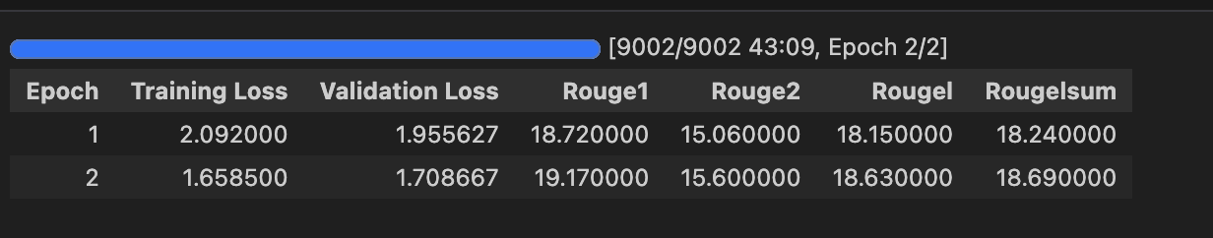
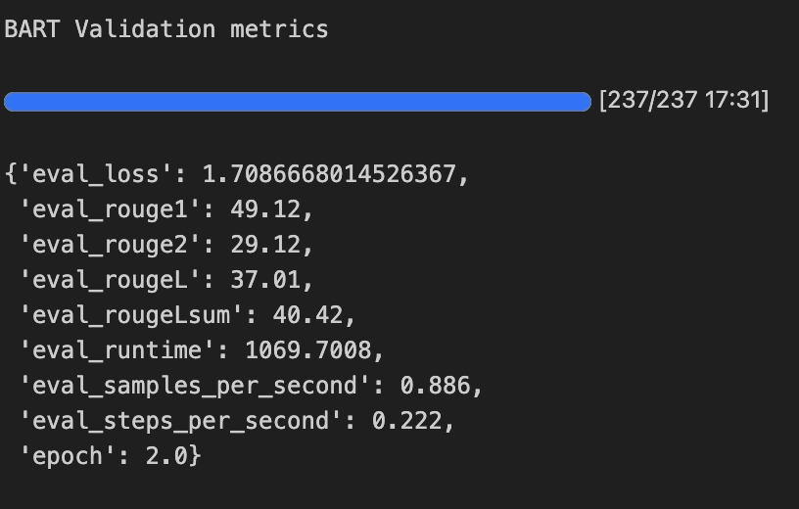
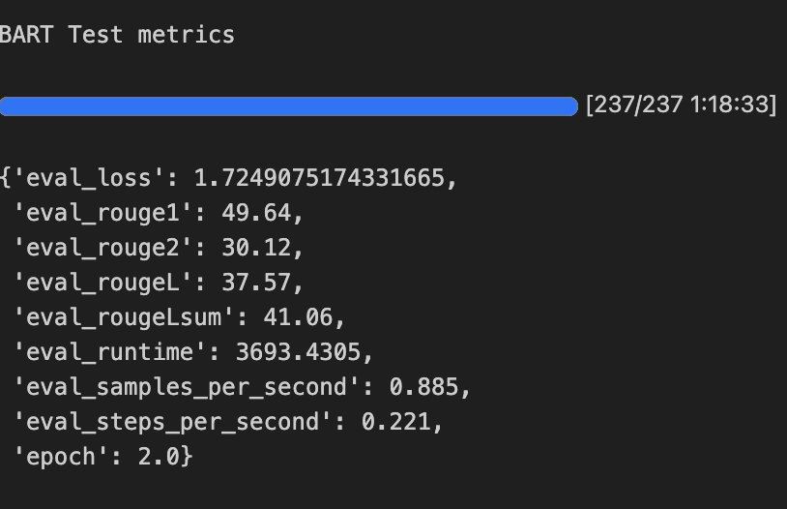
BART Model Results

Slide 21
COMPUTATIONAL PERFORMANCE
Training Time:
Fine-tuning took 40–60 minutes on A100 GPUs due to long sequences and high token counts.
Inference Speed:
T5: very fast, suitable for real-time usage
BART: slightly slower but more expressive
Groq LLM: extremely fast generative responses
RAG Latency:
Embedding retrieval executes in milliseconds, making RAG suitable for real-time applications.

Slide 22
CHALLENGES
Token Limits:
Transformers struggle with very long legal documents, requiring chunking and careful context management.
Model Loading Issues:
Local loading of fine-tuned BART/T5 required careful directory structure and dependency handling.
RAG Implementation:
Building an accurate embedding retrieval system required tuning chunk sizes and embedding models.

Slide 23
FUTURE WORK
Citation Linking:
Integrate APIs like Cornell LII to link extracted text to real legal statutes.
Multi-Document RAG:
Allow the assistant to analyze multiple bills and provide cross-document answers.
Cloud Deployment:
Host the backend on GPU-enabled services for real-time production use.
Advanced Legal Models:
Fine-tune LegalBERT or Lawformer for legal-domain NER and reasoning.
PDF Annotation:
Highlight risk zones, definitions, and obligations directly inside uploaded PDFs.

Slide 24
CONCLUSION
This project successfully delivers a full-stack NLP assistant tailored for legal document understanding.
It integrates summarization, QA, RAG, entity extraction, conversational AI, and risk classification into a unified system.
The system is practical, modular, and scalable, with multiple transformer models and real-time inference engines.
It demonstrates strong technical depth, originality, and real-world relevance.

Slide 25
Thank You

